Slide 1
Home task

Slide 2
Write down possible string of languages
Example: The language INTEGER, of strings defined over Σ={-,0,1,2,3,4,5,6,7,8,9}, can be written as
The language EQUAL, of strings with number of a’s equal to number of b’s, defined over Σ={a,b}
The language EVEN-EVEN, of strings with even number of a’s and even number of b’s, defined over Σ={a,b}
The language {a^{n}b^{n} }, of strings defined over Σ={a,b}
The language FACTORIAL, of strings defined over Σ={a}, as
{a^{n!} : n=1,2,3,…}

Slide 3
DFA and NFA of language
all binary strings with substring 001
all binary strings without substring 001
Even A- Odd B over alphabet {a,b}.
2 mod 3 over alphabet {a,b}.
Not two consecutive zero over alphabet {0,1}.
L = {w belongs to {a,b}*: w does not end in aa}.

Slide 4
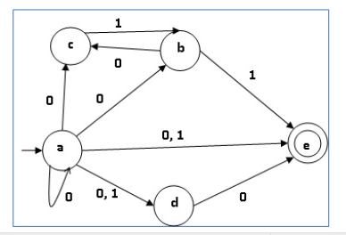
Convert NFA to DFA

Slide 5
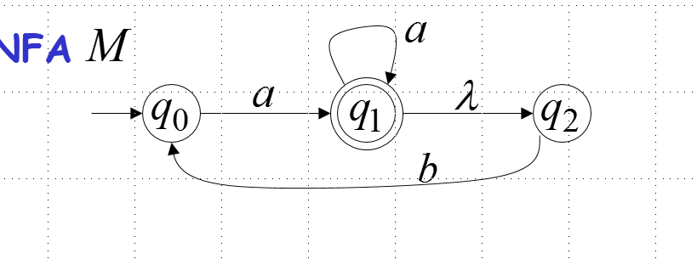
Convert epsilon NFA to DFA

Slide 6
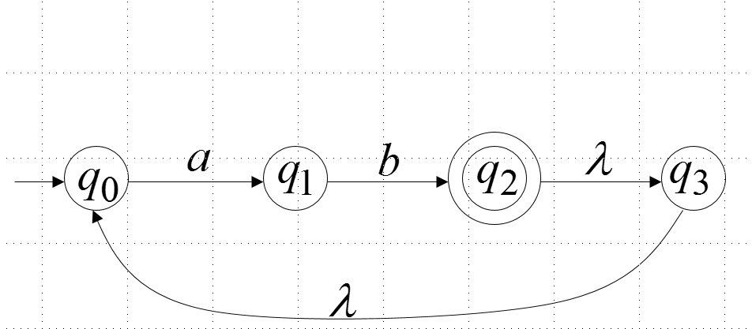
Convert epsilon NFA to DFA AND NFA

Slide 7
Write down regular language and draw DFA and NFA
Consider the language L, defined over Σ={a, b}, in which a’s occur only in even clumps and that ends in three or more b’s.
Even-Even language

Slide 8
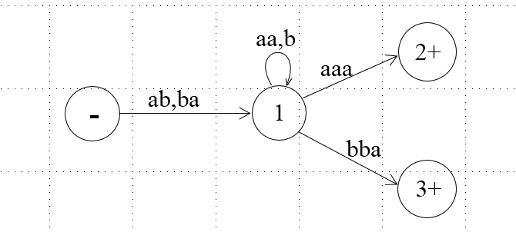
Prove kleenes theorem part 2

Slide 9
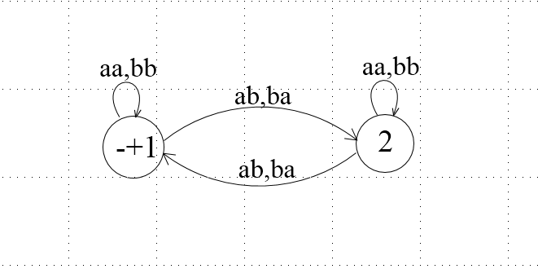
Prove kleenes theorem part 2

Slide 10
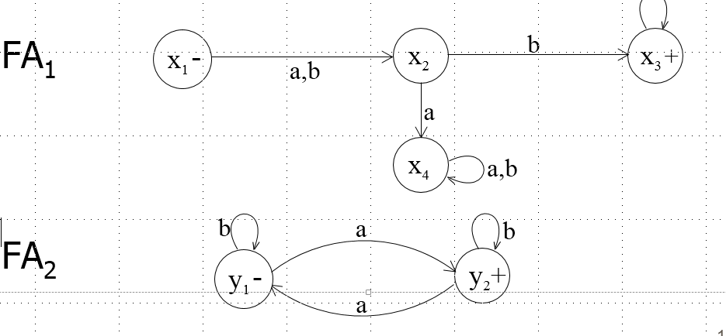
Prove kleenes theorem part 3
a,b

